Slide 1
ML Project Pipeline

Slide 2


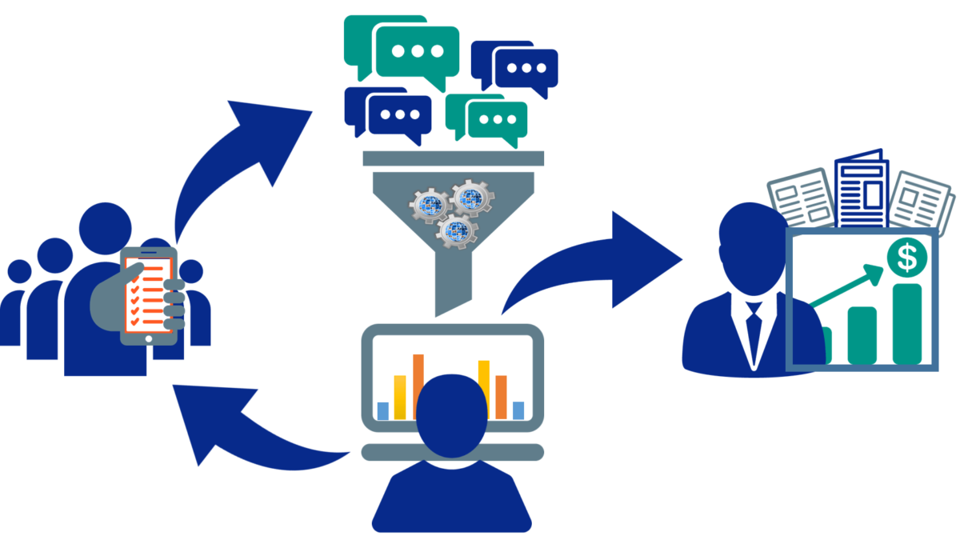
1. Data Collection
Sources:
Kaggle datasets (kaggle API, direct download)
UCI Machine Learning Repository
Google Dataset Search
Open Data platforms (e.g., government data, research datasets)
APIs (Twitter, OpenWeather, etc.)
Web Scraping (BeautifulSoup, Scrapy)
Formats:
CSV, JSON, XML, SQL databases, Parquet, etc.

Slide 3

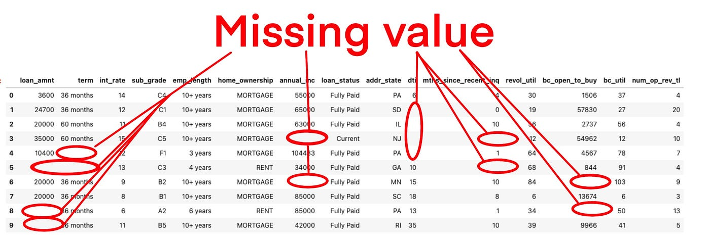
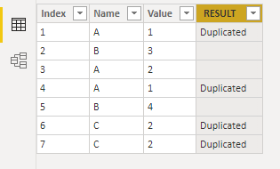
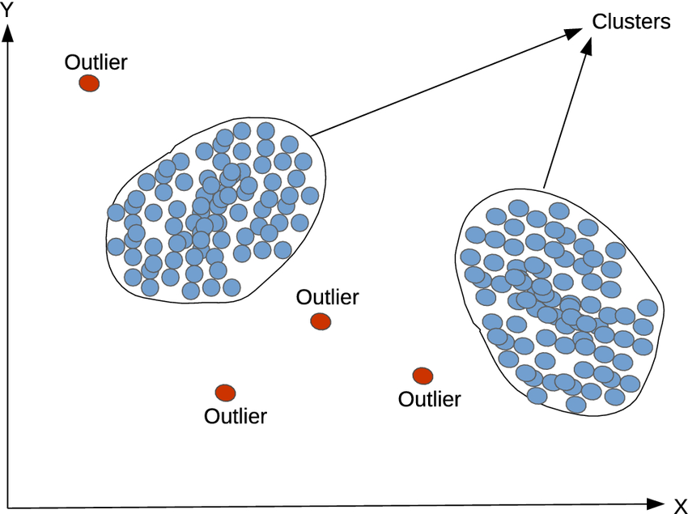
2. Data Preprocessing & Cleaning
Handling Missing Values
Drop rows/columns with too many missing values
Impute using mean, median, mode, or predictive modeling
Removing Duplicates
Handling Date and Time Features
Convert formats (YYYY-MM-DD, Unix Timestamp)
Extract features like year, month, day, weekday, etc.
Handling Outliers
Z-score method, IQR method, or domain-specific logic
Text Cleaning (if NLP-related task)
Lowercasing, stopword removal, stemming, lemmatization

Slide 4
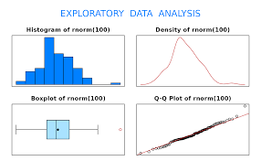
3. Exploratory Data Analysis (EDA)
Descriptive Statistics (df.describe(), df.info())
Visualizations
Distribution plots (sns.histplot, sns.kdeplot)
Boxplots for outlier detection
Correlation matrix (sns.heatmap)
Pairplots (sns.pairplot)
Word clouds for NLP tasks

Slide 5
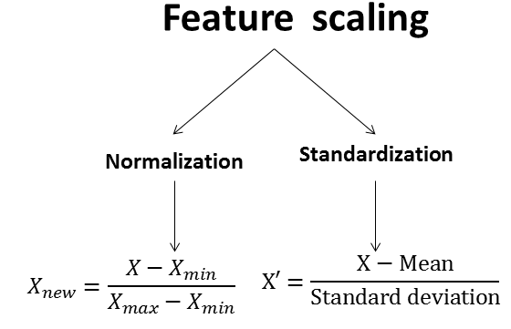
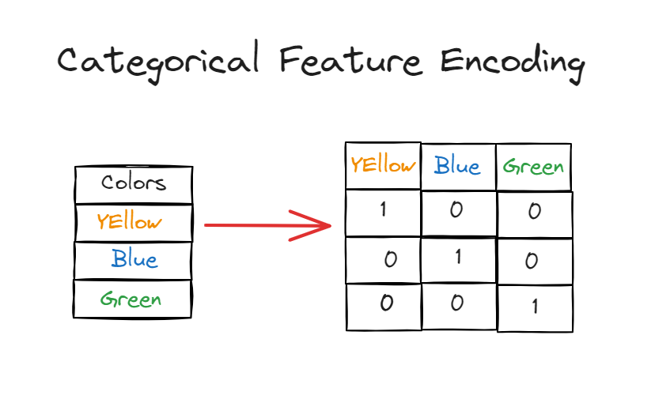
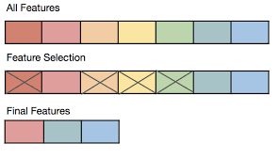
4. Feature Engineering
Feature Creation
Polynomial Features, Interaction Features
Aggregated features (Mean, Sum, etc.)
Feature Encoding
Categorical Encoding: One-hot, Label, Target Encoding
Feature Scaling
Normalization (MinMaxScaler)
Standardization (StandardScaler)
Feature Selection
Statistical tests (Chi-square, ANOVA)
Recursive Feature Elimination (RFE)
Model-based selection (e.g., Feature Importance from tree-based models)

Slide 6
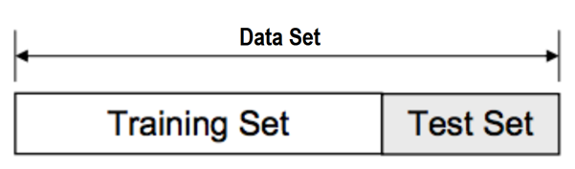
5. Train-Test Split
Splitting Data (train_test_split from sklearn)
Train: 70-80%
Test: 20-30%
Cross-Validation
K-Fold, Stratified K-Fold, Time Series Split

Slide 7
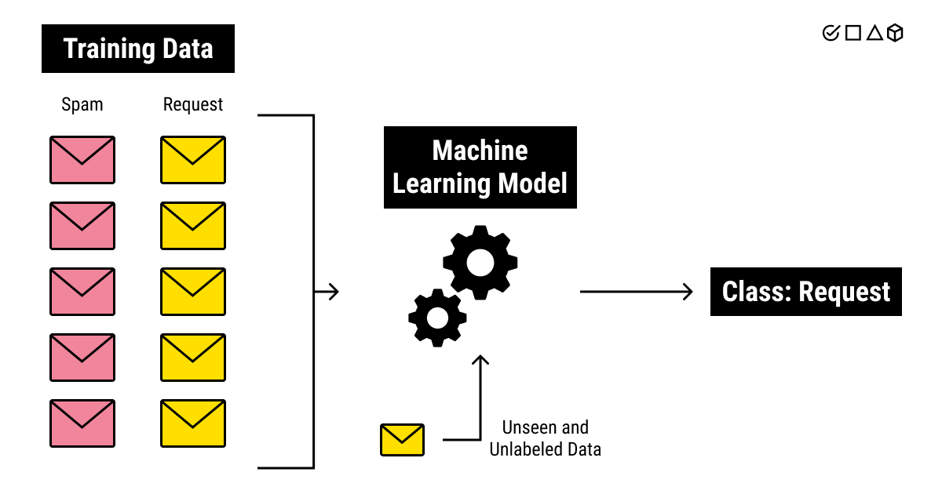
6. Model Training
Choosing the Model
Regression: Linear Regression, Random Forest, XGBoost
Classification: Logistic Regression, SVM, Neural Networks
Clustering: K-Means, Hierarchical, DBSCAN
Deep Learning: CNNs (for images), RNNs (for text)
Hyperparameter Tuning
GridSearchCV, RandomizedSearchCV, Bayesian Optimization

Slide 8
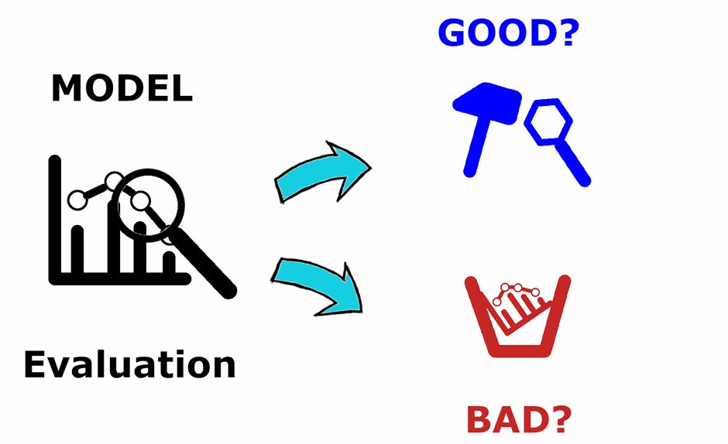
7. Model Evaluation
Metrics Selection
Regression: MAE, MSE, RMSE, R²
Classification: Accuracy, Precision, Recall, F1-score, AUC-ROC
Clustering: Silhouette Score, Davies-Bouldin Index
Confusion Matrix for Classification Tasks
Residual Plots for Regression Tasks

Slide 9
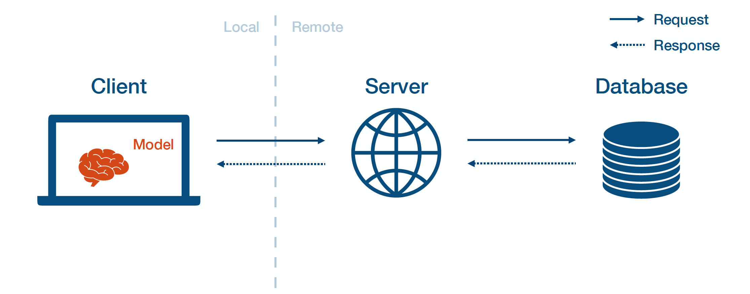
8. Model Deployment
Saving the Model
pickle or joblib
TensorFlow/Keras models (.h5 format)
Deployment Methods
Flask/FastAPI: Web-based API
Streamlit/Gradio: Interactive UI
Cloud Deployment: AWS, GCP, Azure
ML Pipelines: MLflow, Kubeflow, Docker

